Slide 1

4th International Conference on Electrical, Computer and Communication Engineering (ECCE 2025)
Spectrogram-driven Emotion Detection from Electroencephalogram
Paper ID: 611
Authors
Md. Taisirul Muktadi, Tanzeem Tahmeed Reza, Mohammed Tawshif Hossain, Eshat Jahan Arifa, Md. Fazlul Karim Khondakar
Chittagong University of Engineering and Technology (CUET),
Chittagong, Bangladesh
01

Slide 2
Outlines
Introduction
Problem Statement
Research Objectives
Related Works
Methodology
Results
Conclusion
References
02

Slide 3
Introduction
Emotions profoundly shape cognition, guiding decision-making, social interactions and motivation. They shape how individuals interpret, respond and interact with their surroundings [1].
Electroencephalography is the measure of brain's electrical activity that reflects neural oscillations, network dynamics and offers crucial insights into neurocognition [2].
Spectrogram visualizes the dynamic spectral composition of EEG signals, enabling emotion recognition more reliable, accurate and efficient.
The research paper presented here proposes spectrogram based deep learning classification to advance EEG-based emotion recognition system.
4th International Conference on Electrical, Computer and Communication Engineering (ECCE 2025)
03

Slide 4
Problem Statement
01
02
03
Traditional EEG-based emotion recognition cannot completely capture the complex temporal and spectral characteristics of EEG signals.
Spectrogram based emotion detection from EEG is not available.
Classifiers fail to incorporate both spatial and temporal aspects of EEG data, limiting their effectiveness.
4th International Conference on Electrical, Computer and Communication Engineering (ECCE 2025)
04

Slide 5
Research Objectives
To transform the processed EEG signals into spectrogram based representations for improved emotion recognition.
01
To benchmark the effectiveness of the proposed model against state-of-the-art deep learning architectures and prior studies in EEG-based emotion recognition.
02
4th International Conference on Electrical, Computer and Communication Engineering (ECCE 2025)
05

Slide 6
Related Works
Table 1: Related Works
Work | Feature Extraction Method | Models Used | Accuracy | Limitations
Q. Zhao [3] | DE | DE-CNN-RNN | 95% | 1. Exploring only one feature. 2. Did not handle EEG Signals variablities across different individuals.
A. N. A. Gul [4] | DE, DCAU, RASM, DASM | SVM, DNN | SVM- 79.4% DNN - 79.8% | 1. Study is conducted in a controlled environment and no analysis is done on how the model performs in real-world EEG noise and artifacts.
H. Shrara [5] | - | SVM, RF, LSTM | SVM - 90% RF - 93% LSTM - 97% | 1. Small dataset (10 participants) limits generalizability. 2. Limited emotion categories; no mixed emotions considered
P. Kar [6] | WPD | SVM | 64.06% | 1. Discrepancies between established emotion labels and actual physiological responses suggest potential labeling inaccuracies 2.Limited classification accuracy
4th International Conference on Electrical, Computer and Communication Engineering (ECCE 2025)
06

Slide 7
Methodology
Proposed Workflow
Phase 1
Phase 2
Phase 3
Phase 4
Data Collection
EEG Processing
Feature Extraction
Classification
SJTU Emotion EEG dataset
No. of channel used 15
Sampling Frequency 200 Hz
Extraction of 675 MATLAB files carrying signals
Short Time Fourier Transform
Spectrograms (Time and frequency representation)
Convolutional Neural Networks
4th International Conference on Electrical, Computer and Communication Engineering (ECCE 2025)
07

Slide 8

Methodology (Cont.)
Dataset
SJTU Emotion EEG Dataset (SEED) [7,8]
15 Volunteers
Chinese emotional movie clips
62 channels with 1000 Hz Sampling rate
Downsampled to 200 Hz
4th International Conference on Electrical, Computer and Communication Engineering (ECCE 2025)
08

Slide 9
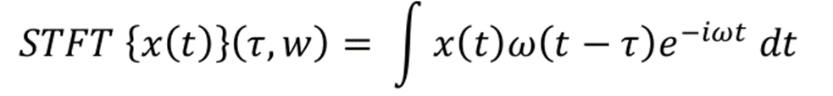
Methodology (Cont.)
Feature Extraction
Table 2: Parameters used for STFT
Generated energy-time-frequency representations, visualized as spectrograms
Parameters | Conditions
Sampling Frequency | 256 Hz
Length of each segment | 256
No. of Points to overlap | 128
No.of FFT Points | 128
Short Time Fourier Transform (STFT) provided spectrograms of selected channels
Fig. 1. Equation of STFT [9]
15 Channels Used
FP1,FP2,F3,F4,F8,F7,AF3,AF4,F2,P5,P3,PZ,C3,C4,CZ
4th International Conference on Electrical, Computer and Communication Engineering (ECCE 2025)
09

Slide 10
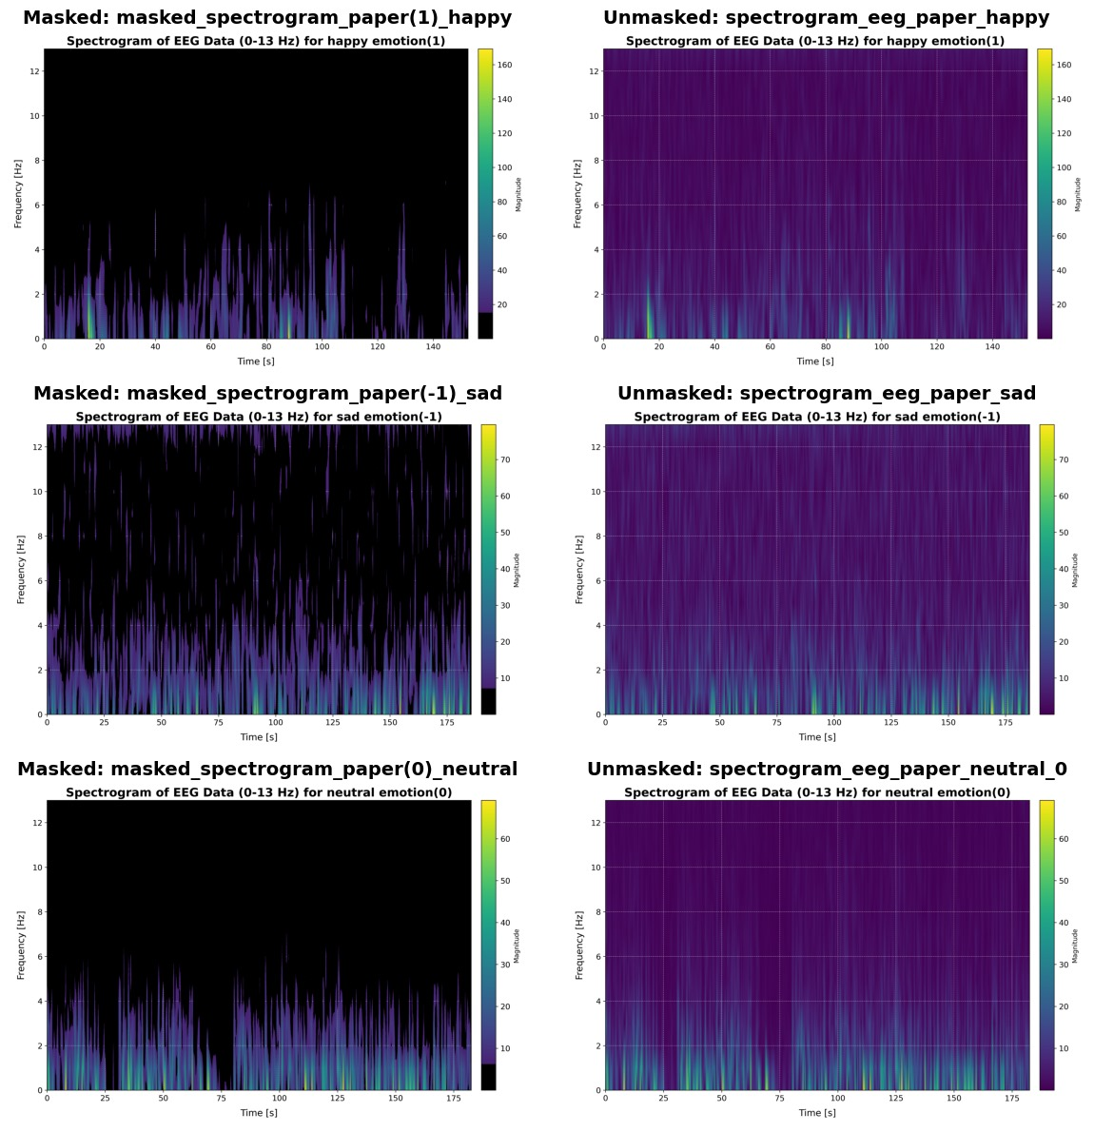
Methodology (Cont.)
Spectrograms
Table 3: Parameters used in image processing
Parameters | Conditions
Batch Size | 40
Brightness | 0.8
Random Contrast | Lower = 0.32 Upper =1.1
Random Rotation | 0.03
Random Zoom | 0.4
Fig. 1. Original Spectrograms derived from MATLAB (left) and processed Spectrograms (right)
4th International Conference on Electrical, Computer and Communication Engineering (ECCE 2025)
10

Slide 11
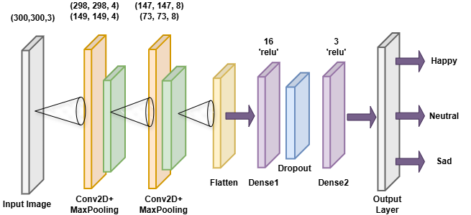
Methodology (Cont.)
CNN Model Architecture
Table 4: Parameters used in CNN Model
Parameters | Conditions
Learning Rate | 0.0001
Optimizer | ‘Adam’
Epochs | 10
Activation Function | ReLU
Dropout | 0.5
Fig. 2. The CNN Architecture
4th International Conference on Electrical, Computer and Communication Engineering (ECCE 2025)
11

Slide 12
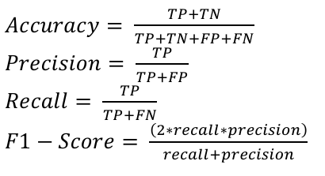
Results
Performance Evaluation
Performance metrics used
Table 5: Parameters used in image processing
Data Condition | No. of trained Images | Performance Metrices
 |  | Accuracy | Precision | Recall | F1-score
Processed Image | 10125 | 0.9980 | 0.9900 | 0.9900 | 0.9900
4th International Conference on Electrical, Computer and Communication Engineering (ECCE 2025)
12

Slide 13
Results (Cont.)
Performance Evaluation for Pre-trained Models
Table 6: Performance evaluation with pre-trained models
Models | Class Labels | Performance Metrics |  |  | Overall accuracy
 |  | Precision | Recall | F1-score
VGG16 | 1 | 1.00 | 1.00 | 1.00 | 0.99
 | 0 | 1.00 | 1.00 | 1.00
 | -1 | 1.00 | 1.00 | 1.00
VGG19 | 1 | 1.00 | 1.00 | 1.00 | 0.98
 | 0 | 0.97 | 1.00 | 0.98
 | -1 | 1.00 | 0.97 | 0.90
InceptionNet | 1 | 1.00 | 0.81 | 0.90 | 0.94
 | 0 | 1.00 | 1.00 | 1.00
 | -1 | 0.85 | 1.00 | 0.92
4th International Conference on Electrical, Computer and Communication Engineering (ECCE 2025)
13

Slide 14
Results (Cont.)
Comparison with Recent Studies
Table 7: Comparison with recent studies
Work | Feature Extraction Method | Models Used | Accuracy
Q. Zhao [3] | DE | DE-CNN-RNN | 95%
A. N. A. Gul [4] | DE, DCAU, RASM, DASM | SVM, DNN | SVM- 79.4% DNN - 79.8%
H. Shrara [5] | - | SVM, RF, LSTM | SVM - 90% RF - 93% LSTM - 97%
P. Kar [6] | WPD | SVM | 64.06%
Proposed Work | STFT | CNN | 99.80%
4th International Conference on Electrical, Computer and Communication Engineering (ECCE 2025)
14

Slide 15
Conclusion
A comprehensive study on emotion recognition using EEG signals using an effective feature extraction method has been done.
Proposed CNN model achieved a high accuracy of 99.80% leveraging the Spectrograms generated by Short Time Fourier Transfrom method.
The findings underscore deep learning models in interpreting EEG signals for emotion detection & provides a foundation for working with time-frequency representations.
4th International Conference on Electrical, Computer and Communication Engineering (ECCE 2025)
15

Slide 16
References
[1] Li, X., Zhang, Y., Tiwari, P., Song, D., Hu, B., Yang, M., Zhao, Z., Kumar, N., & Marttinen, P. (2022). EEG Based Emotion Recognition: A tutorial and review. ACM Computing Surveys, 55(4), 1–57. https://doi.org/10.1145/3524499
[2] D. L. Schomer and F. Lopes da Silva, “Niedermeyer's Electroencephalography: Basic Principles, Clinical Applications, and Related Fields”, 6th ed. Philadelphia, PA: Wolters Kluwer, 2012.
[3] Q. Zhao, Y. Dong, and W. Yin, “Emotion Recognition Based on EEG and DE-CNN-RNN,” 2023 China Automation Congress (CAC), Nov. 2023, doi: 10.1109/cac59555.2023.10450238
[4] A. N. A. Gul and A. Altuntas, “Comparison of EEG- Based Deep Neural Network Classifiers for Emotion Recognition using Selected Electrodes,” 2023 Medical Technologies Congress (TIPTEKNO), pp. 1–4, Nov. 2023, doi: 10.1109/tiptekno59875.2023.10359196
[5] H. Shrara, H. Ammar, M. Nasseredine, J. Charara, and F. Sbeity, "An EEG-Based Emotion Recognition Study Using Machine Learning and Deep Learning," 2023 Seventh International Conference on Advances in Biomedical Engineering (ICABME), 2023, pp. 125-129, doi: 10.1109/ICABME59496.2023.10293013
[6] P. Kar, J. Hazarika, and M. R. Sethi, "A Comparative Study between Supervised and Unsupervised Techniques for Two-Class Emotion Recognition Using EEG," in 2023 IEEE 8th International Conference for Convergence in Technology (I2CT), Pune, India, Apr. 2023, pp. 1-6, doi: 10.1109/I2CT57861.2023.10126336
[7] W. L. Zheng and B. L. Lu, "Investigating Critical Frequency Bands and Channels for EEG-Based Emotion Recognition with Deep Neural Networks," in IEEE Transactions on Autonomous Mental Development, vol. 7, no. 3, pp. 162-175, Sept. 2015, doi: 10.1109/TAMD.2015.2431497
[8] R. N. Duan, J. Y. Zhu and B. L. Lu, "Differential entropy feature for EEG-based emotion classification," 2013 6th International IEEE/EMBS Conference on Neural Engineering (NER), San Diego, CA, USA, 2013, pp. 81-84, doi: 10.1109/NER.2013.6695876.
[9] A. Sulaiman, S. Abdallah, and K. K. George, “On the intersection of signal processing and Machine Learning: A use case-driven analysis approach,” arXiv [eess.SP], 2024
4th International Conference on Electrical, Computer and Communication Engineering (ECCE 2025)
16

Slide 17
THANK YOU
Q&A

